Slide 1
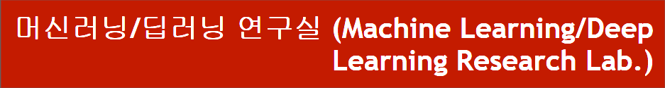
DARTS : DIFFERENTIABLE ARCHITECTURE SEARCH
동서대학교 대학원 컴퓨터공학과
Jie Yong Shin,
Dae-Ki, Kang , Prof (advisor)
2022.02.03
Notes:
1

Slide 2
CONTENTS
1. Summary
2. Search space
3. Continuous relaxation and optimization
4. Approximate architecture gradient
5. Results
6. Conclusion and Discussion
Notes:
2

Slide 3
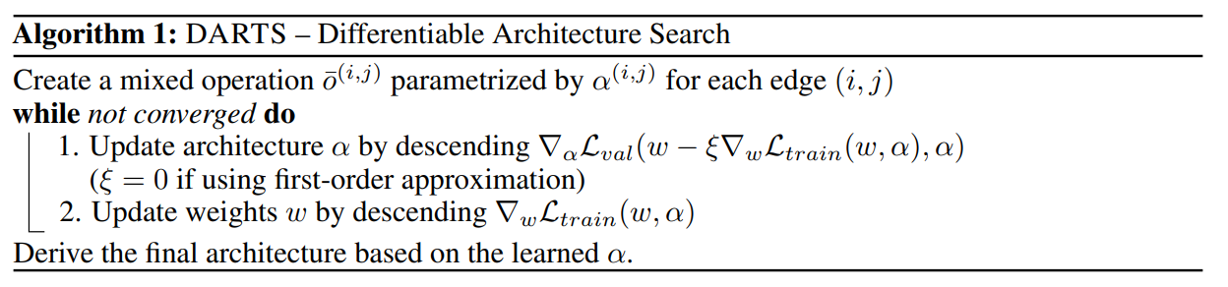
1. Summary
Unlike other papers that approached NAS with reinforcement learning or evolutionary algorithms, this was made differentiable by using graph topology within the Sequential Domain and solved by gradient descent approach
Notes:
3

Slide 4
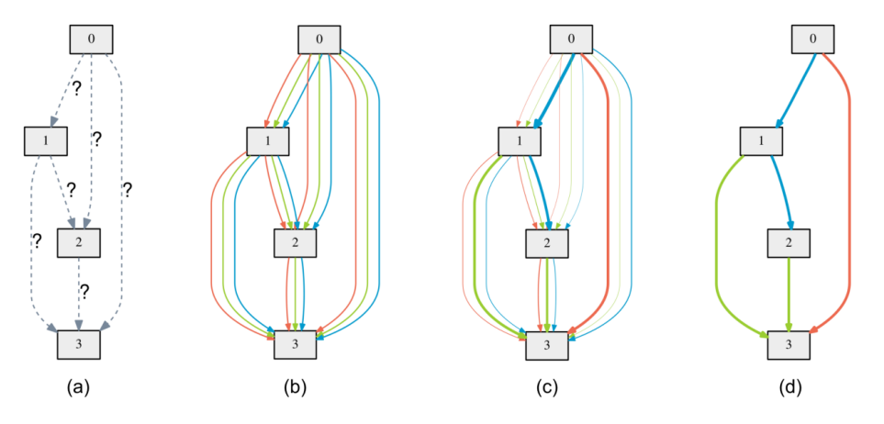
1. Summary
Define Search space as DAG(Directed Acyclic Graph)
Notes:
4

Slide 5
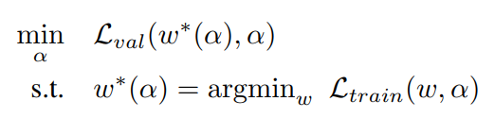
1. Summary
Loss to optimize is w of train loss and α (weight of operation) of validation loss
Notes:
5

Slide 6
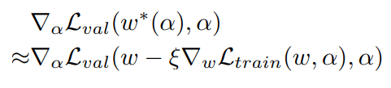
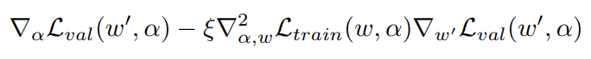
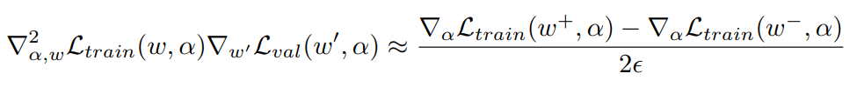
1. Summary
Approximation that significantly reduces search cost
Notes:
6

Slide 7
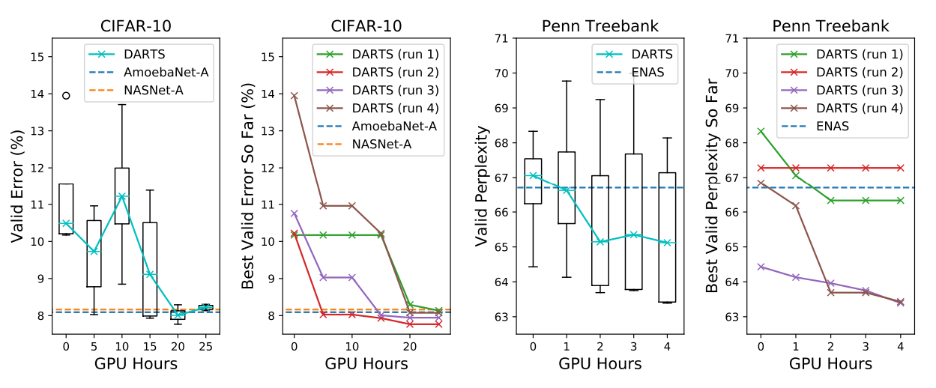
1. Summary
As a result, it outperforms other SOTA algorithms
Notes:
7

Slide 8
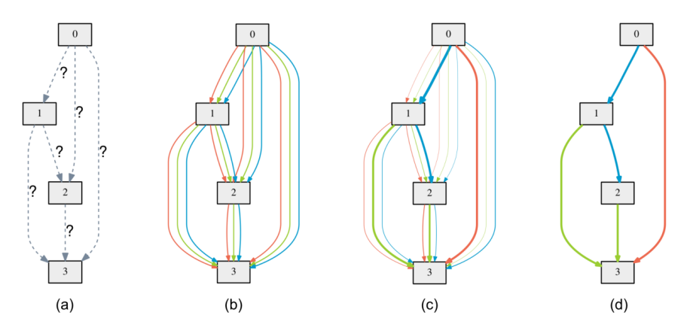
2. Search space
Directed Acyclic Graph
Notes:
8

Slide 9
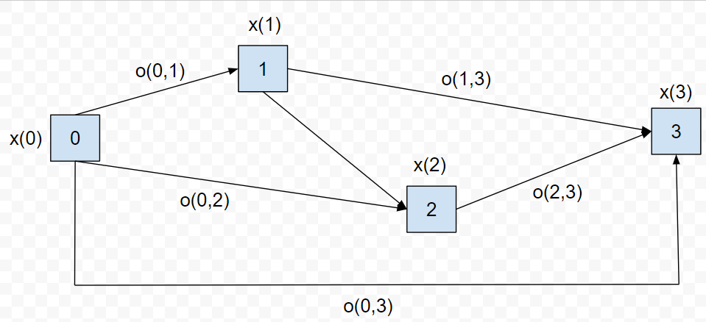
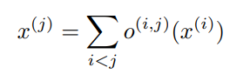
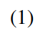
2. Search space
Directed Acyclic Graph
x(i) : input
x(j) : output
o(i,j) : operation (transforms x(i))
Notes:
9

Slide 10
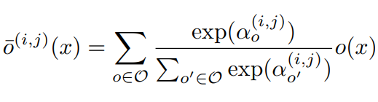
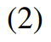
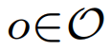
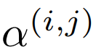
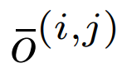
3. Continuous relaxation and optimization
Example of a set O : {convolution, pooling, none}
: Weights of operations (Vector)
: Mixed operation
Notes:
10

Slide 11
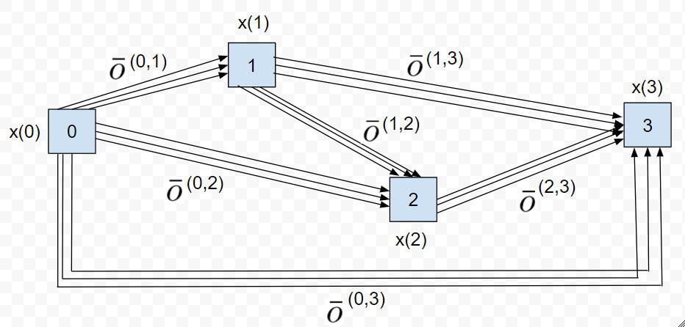
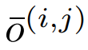
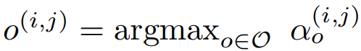
3. Continuous relaxation and optimization
The task of architecture search then reduces to learning a set of continuous variables α = { α (i,j) }
At the end of the search, replace
with
Notes:
11

Slide 12
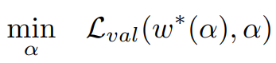
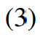
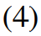
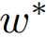
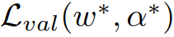
3. Continuous relaxation and optimization
: weight one step after w
Goal is to find α* that minimizes
(4) is bilevel optimization problem
Notes:
12

Slide 13
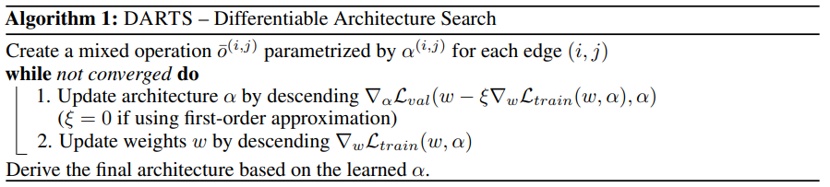
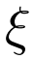
4. Approximation
: Learning rate for a step of inner optimization
Notes:
13

Slide 14
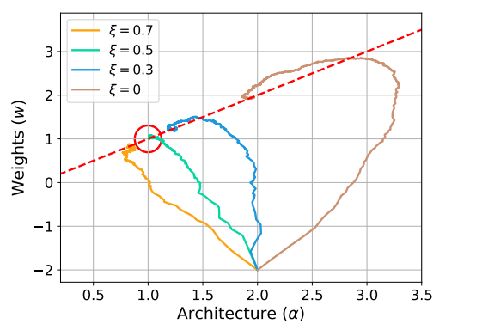
4. Results
The example shows that a suitable choice of ξ helps to converge to a better local optimum.
Notes:
14

Slide 15
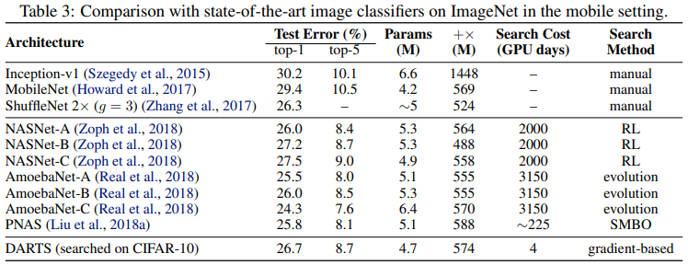
4. Results
Transfer learning with DARTS
Notes:
15

Slide 16
5. Conclusion
Optimization gap
discrepancies between the continuous architecture encoding and the derived discrete architecture.
This could be alleviated by annealing the softmax temperature (with a suitable schedule) to enforce one-hot selection.
Performance-aware architecture derivation schemes based on the shared parameters learned during the search process.
Notes:
16

Slide 17
감사합니다.
Q & A
17
Notes:
-
The training of procedure for is to maximize the probability of D making a mistake. This framework corresponds to a minimax two-player game.
In the space of arbitrary functions G and D, a unique solution exists, with G recovering the training data distribution and D equal to ½ everywhere.
17

Slide 18
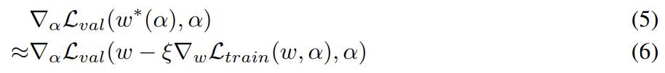
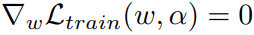
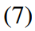
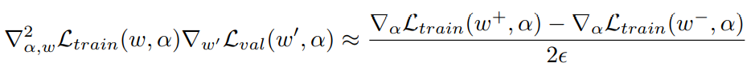
4. Approximation
Simple approximation
Approximate with one single step
Applying chain rule to the approximate architecture gradient
Finite difference approximation
Notes:
18

